Slide 1



32 Smile.com: Your Complete Dental Health Solution
Author: HAFSA
Created with Pi

Slide 2

CONTENTS
1. Introduction & Our Vision
2. Why Choose 32 Smile? (Key Differentiators)
3. Comprehensive Dental Services
4. About Our Clinic
5. Meet Our Expert Team
6. Easy Appointment Booking
7. What Our Patients Say
8. Frequently Asked Questions (FAQ)
9. Contact Us & Call to Action
10. Thank You / Q&A

Slide 3

1
Educational dental resources
Target Audience
Patients seeking dental care
Purpose:
Families (pediatric dentistry)
The 32 Smile.com website serves as an online platform for a modern dental clinic, offering:
Individuals interested in cosmetic dental procedures
Emergency dental patients
Appointment booking
Service information
Dentist profiles
Patient testimonials
Introduction

Slide 4


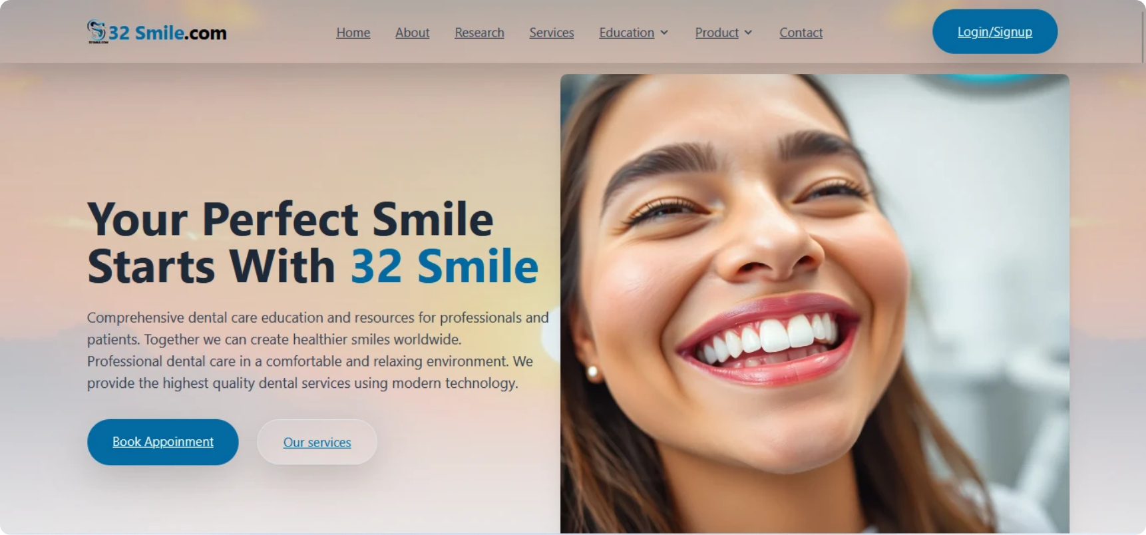

Welcome to 32 Smile.com
1
Who we are
2
Our Mission
3
Our Vision
A leading dental care provider.
To provide comprehensive, high-quality dental care in a comfortable and relaxing environment.
To create healthier smiles worldwide through modern technology and compassionate service.
![The inviting hero section of our homepage, showcasing our brand and core message.](hero img2.webp "Hero Section Screenshot")

Slide 5




The 32 Smile Advantage
Experience: 15+ Years in Dental Care.
Patient Satisfaction: 5,000+ Happy Patients.
Safety & Hygiene: 100% Sterilized Equipment.
Accessibility: 24/7 Emergency Service.
![Our commitment to excellence, quantified: years of experience, patient satisfaction, and safety standards.](Stats Section Screenshot "Stats Section Screenshot")

Slide 6


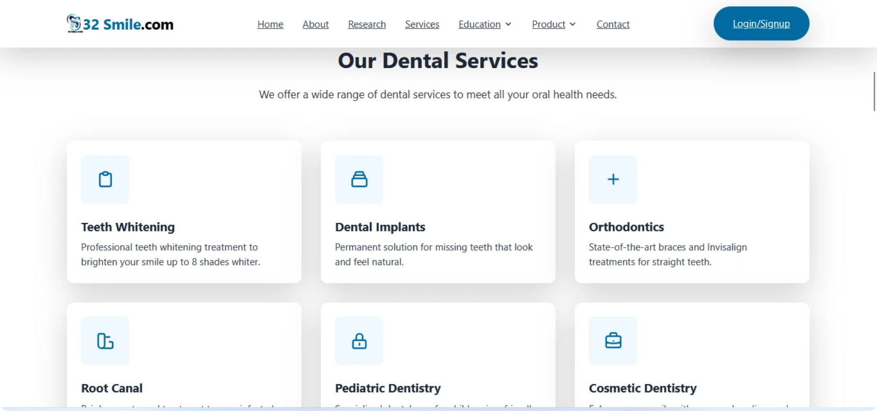
Comprehensive Dental Services

Slide 7
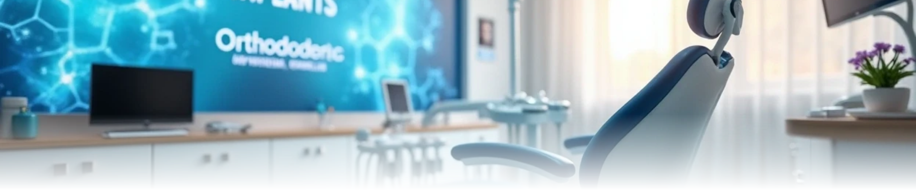
Our Wide Range of Dental Services
1
Highlight popular services: Teeth Whitening, Dental Implants, Orthodontics.
2
Mention specialized care: Pediatric Dentistry, Root Canal, Cosmetic Dentistry.
3
Emphasize modern techniques and patient comfort.
![A glimpse into our diverse service offerings, designed to meet every oral health need.](Services Section Screenshot "Services Section Screenshot")

Slide 8


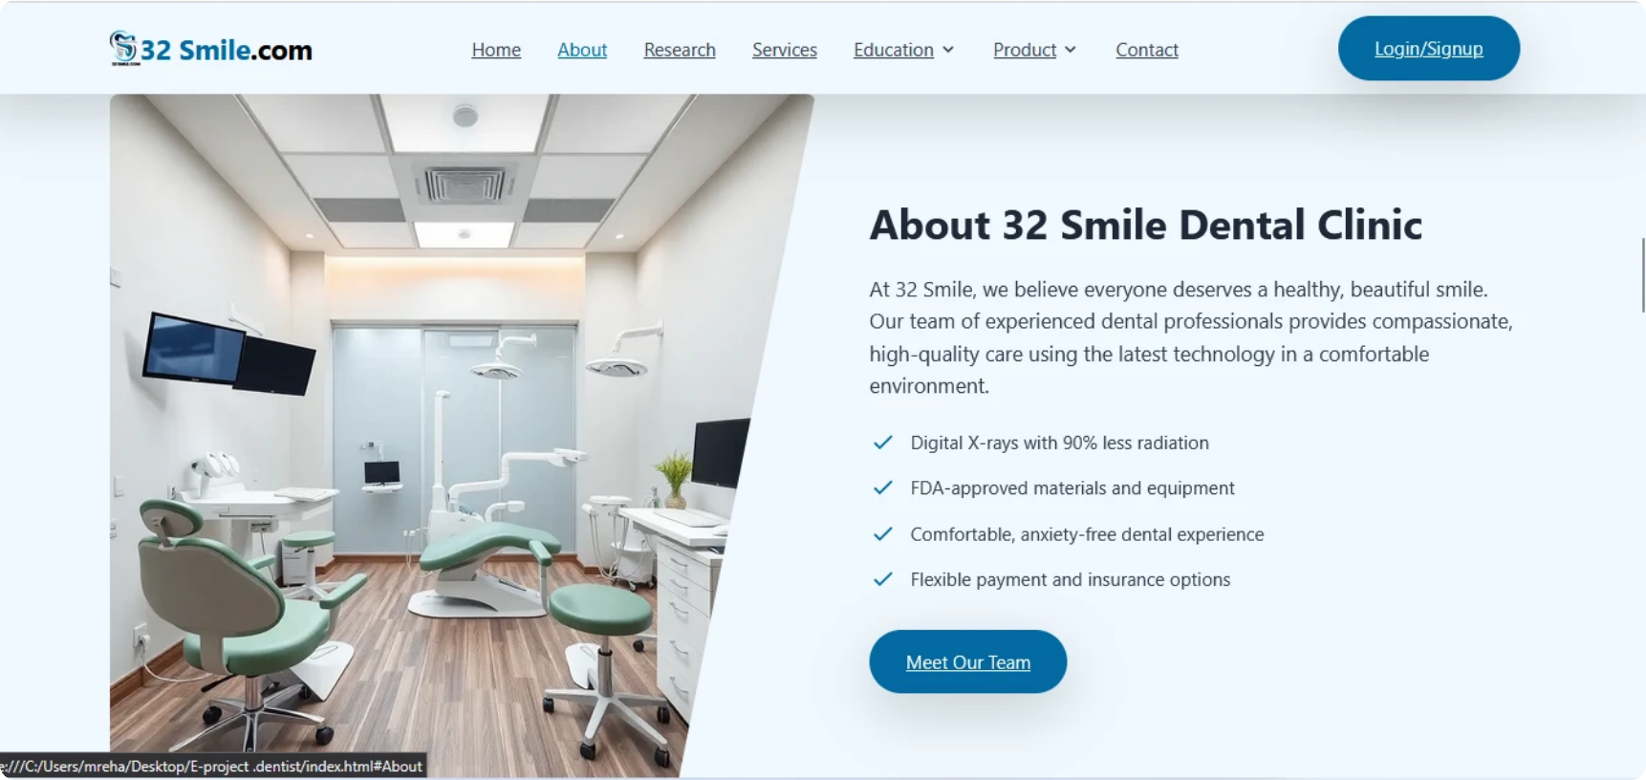
About Our Clinic

Slide 9



Discover the 32 Smile Difference
Our Philosophy
Advanced Technology
Patient Experience
Healthy, beautiful smiles for everyone.
Digital X-rays, FDA-approved materials.
Anxiety-free environment, flexible options.

Slide 10


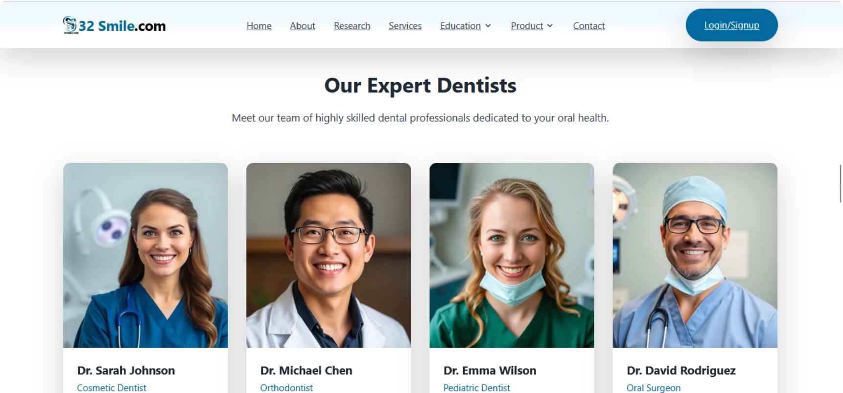
Meet Our Expert Team

Slide 11

Our Dedicated Dental Professionals
1
Introduce the team: Dr. Sarah Johnson (Cosmetic), Dr. Michael Chen (Orthodontist), Dr. Emma Wilson (Pediatric), Dr. David Rodriguez (Oral Surgeon).
2
Highlight their expertise and years of experience.
3
Emphasize their compassionate care.
![Meet the highly skilled and compassionate dentists who make up the 32 Smile team.](Dentists Section Screenshot "Dentists Section Screenshot")

Slide 12


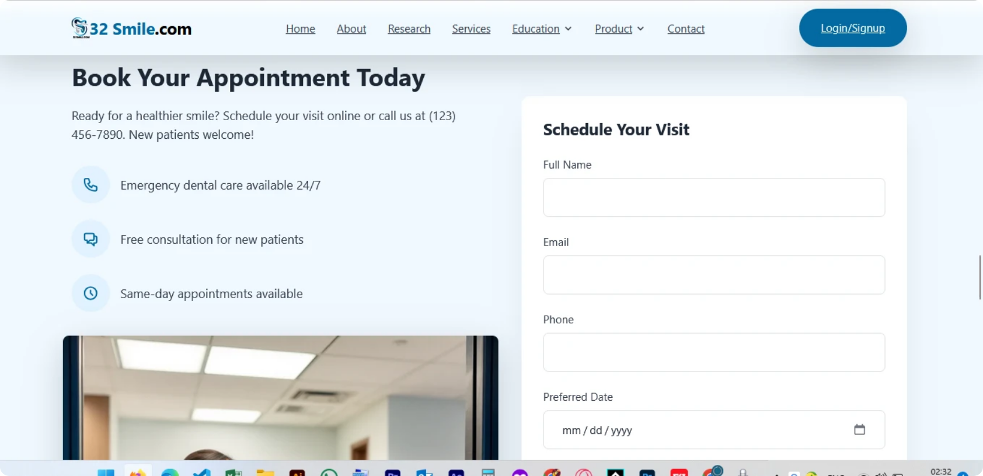
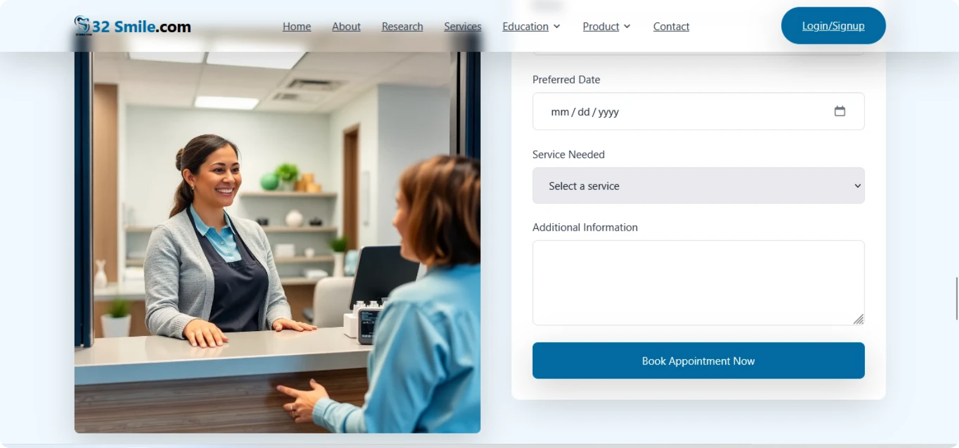
Easy Appointment Booking

Slide 13




Schedule Your Visit with Ease
Convenient online booking.
Emergency care availability.
Free consultations for new patients.
Same-day appointments.

Slide 14


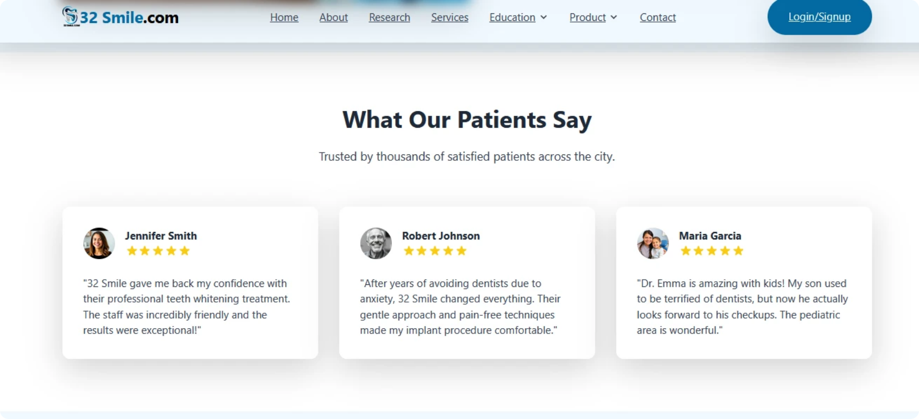
What Our Patients Say

Slide 15

Voices of Satisfaction: Patient Testimonials
1
Showcase positive feedback from diverse patients (Teeth Whitening, Implants, Pediatric).
2
Reinforce trust and quality of service.
![Authentic feedback from our happy patients, reflecting their positive experiences.](Testimonials Section Screenshot "Testimonials Section Screenshot")

Slide 16


Your Questions Answered
Address common queries about visits, insurance, and emergencies.
Demonstrate transparency and helpfulness.
![A quick reference for common inquiries, providing clear and helpful information.](FAQ Section Screenshot "FAQ Section Screenshot")

Slide 17
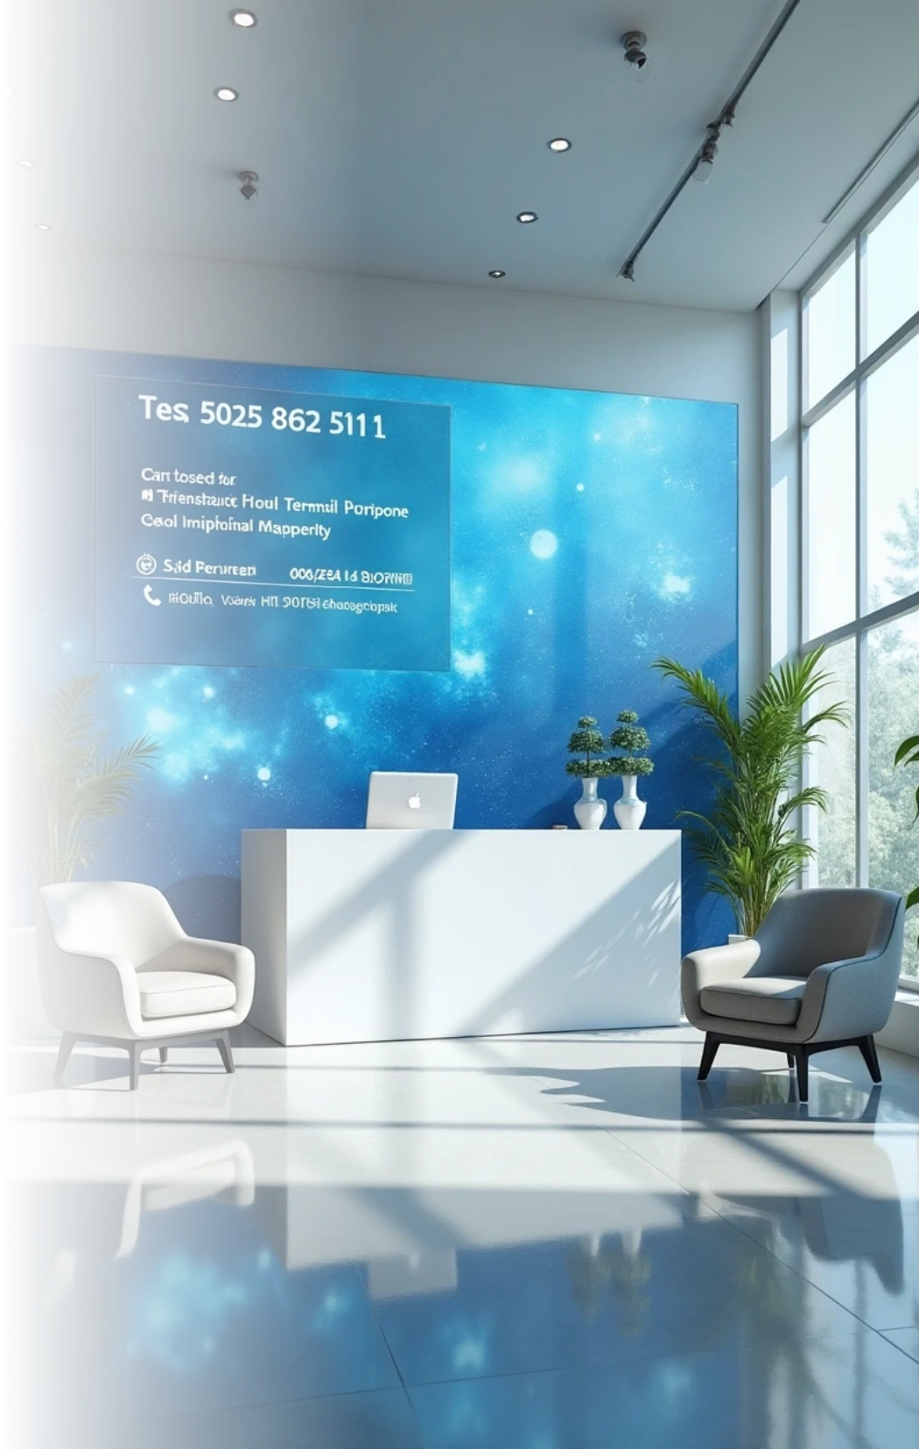
Connect With 32 Smile.com
1
Location details.
2
Phone number and email.
3
Operating hours.
4
Encourage visitors to book an appointment or reach out.
![Our comprehensive footer, providing all necessary contact details and quick navigation.](Footer Section Screenshot "Footer Section Screenshot")

Slide 18




Thank You!
32 Smile.com
"Your journey to a healthier, brighter smile starts here."
123-4567-89
"Questions?"

Slide 19

Thank You

